Slide 1
Defect Lifecycle
Presented By:
Shankar Khatri
Arun Amatya

Slide 2
What is Defect Lifecycle?
Defect life cycle is a cycle which a defect goes through during its lifetime. It starts when defect is found and ends when a defect is closed, after ensuring it’s not reproduced.
Defect life cycle is related to the bug found during testing.

Slide 3
Types of Defects
Severity Wise: Minor: A defect that will not cause a failure in execution of the product. Major: A defect, which will cause an observable product failure or departure from requirements. Fatal: A defect that will cause the system to crash or close abruptly or effect other applications.

Slide 4
Types of Defects (contd..)
Work product wise:
SSD: A defect from System Study document
FSD: A defect from Functional Specification document
ADS: A defect from Architectural Design Document
DDS: A defect from Detailed Design document
Source code: A defect from Source code
Test Plan/ Test Cases: A defect from Test Plan/ Test Cases
User Documentation: A defect from User manuals, Operating manuals

Slide 5
Types of Defects (Error Wise)
Comments: Inadequate/ incorrect/ misleading or missing comments in the source code Computational Error: Improper computation of the formulae / improper business validations in code. Data error: Incorrect data population / update in database Database Error: Error in the database schema/Design Missing Design: Design features/approach missed/not documented in the design document and hence does not correspond to requirements Inadequate or sub optimal Design: Design features/approach needs additional inputs for it to be complete. Design features described does not provide the best approach (optimal approach) towards the solution required In correct Design: Wrong or inaccurate Design Ambiguous Design: Design feature/approach is not clear to the reviewer. Also includes ambiguous use of words or unclear design features. Boundary Conditions Neglected: Boundary conditions not addressed/incorrect Interface Error: Internal or external to application interfacing error, Incorrect handling of passing parameters, Incorrect alignment, incorrect/misplaced fields/objects, un friendly window/screen positions Logic Error: Missing or Inadequate or irrelevant or ambiguous functionality in source code Message Error: Inadequate/ incorrect/ misleading or missing error messages in source code

Slide 6
Types of Defects (Error Wise) contd..
Navigation Error: Navigation not coded correctly in source code Performance Error: An error related to performance/optimality of the code Missing Requirements: Implicit/Explicit requirements are missed/not documented during requirement phase Inadequate Requirements: Requirement needs additional inputs for to be complete Incorrect Requirements: Wrong or inaccurate requirements Ambiguous Requirements: Requirement is not clear to the reviewer. Also includes ambiguous use of words – e.g. Like, such as, may be, could be, might etc. Sequencing / Timing Error: Error due to incorrect/missing consideration to timeouts and improper/missing sequencing in source code. Standards: Standards not followed like improper exception handling, use of E & D Formats and project related design/requirements/coding standards System Error: Hardware and Operating System related error, Memory leak Test Plan / Cases Error: Inadequate/ incorrect/ ambiguous or duplicate or missing - Test Plan/ Test Cases & Test Scripts, Incorrect/Incomplete test setup Typographical Error: Spelling / Grammar mistake in documents/source code Variable Declaration Error: Improper declaration / usage of variables, Type mismatch error in source code

Slide 7
Defect Lifecycle
New
Assign
Rejected
Open
Deferred
Reopened
Test
Verified
Closed

Slide 8
Thank You

Slide 9
Thank You

Slide 11
New
Assign
Open
Test
Verified
Closed

Slide 12
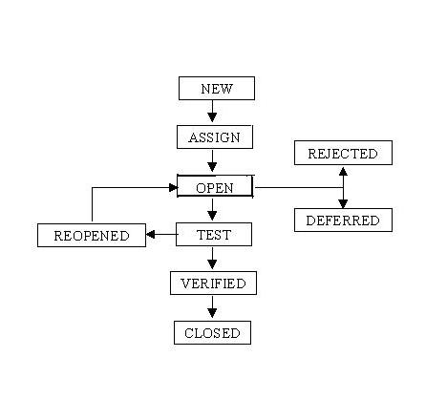
Defect Lifecycle

